Slide 1
Welcome to the OOI Teaching with Data Workshop
Janice McDonnell, Kristin Hunter-Thomson & Sage Lichtenwalner, Rutgers University
Annette deCharon, University of Maine
Al Trujillo, Palomar College
Catherine Halversen, Lawrence Hall of Science
Erin Bardar, EDC

Slide 2
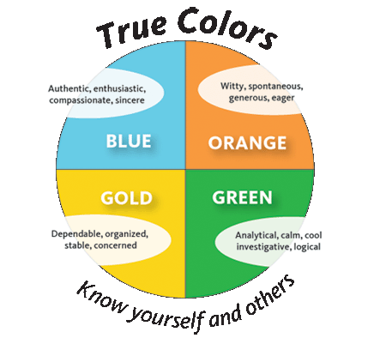
Icebreaker

Slide 3
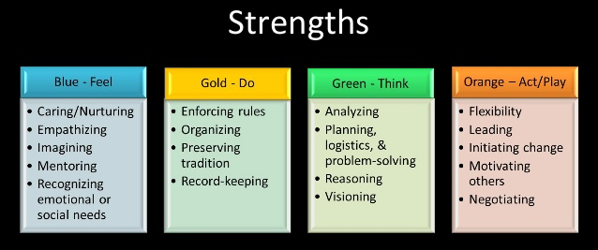
Ice Breaker

Slide 4
Introduction to the OOI
Sage Lichtenwalner, Rutgers University

Slide 5
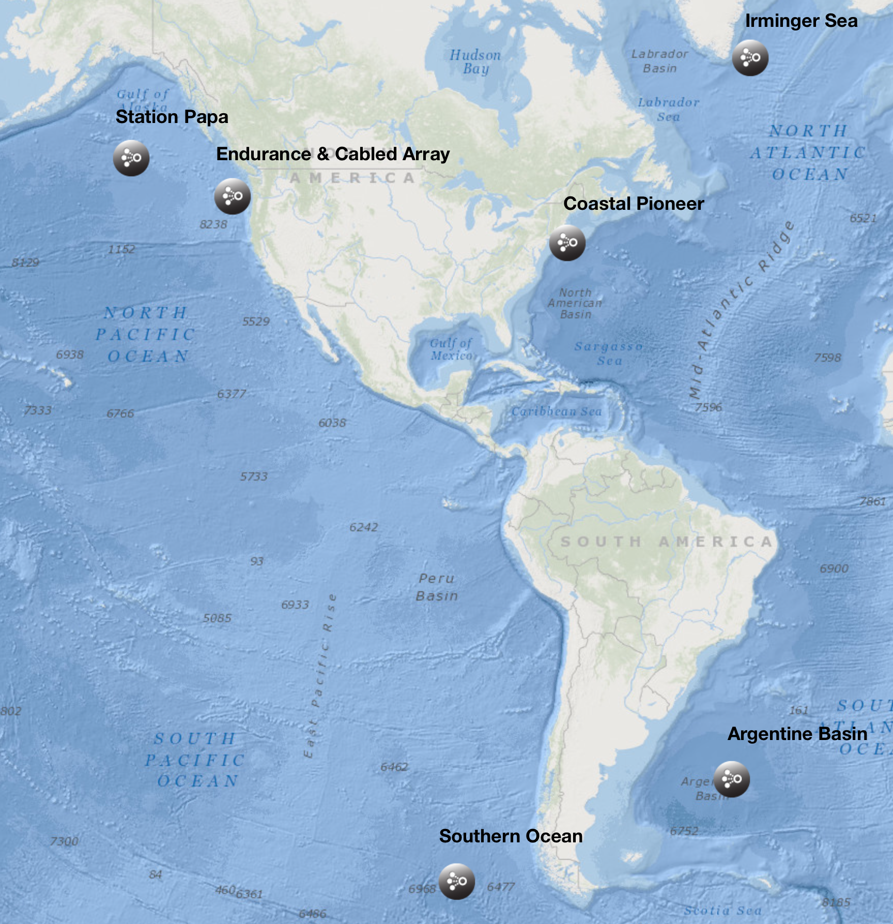
The Ocean Observatories Initiative (OOI)
Sage Lichtenwalner
Rutgers University
www.oceanobservatories.org

Slide 6
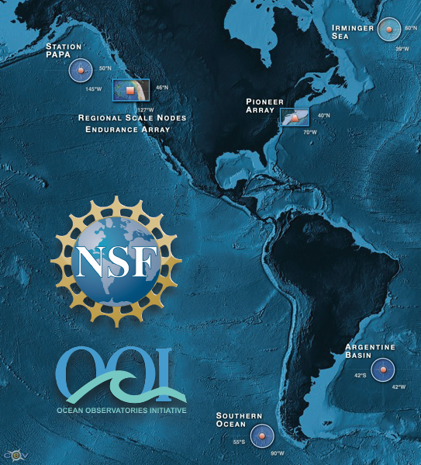
NSF’s Ocean Observing Initiative
Five Integrated Components
4 High Latitude Global Sites
Regional Plate-scale Cable
2 Coastal Dynamics Arrays
Data Management System
Ocean Education Portal

Slide 7
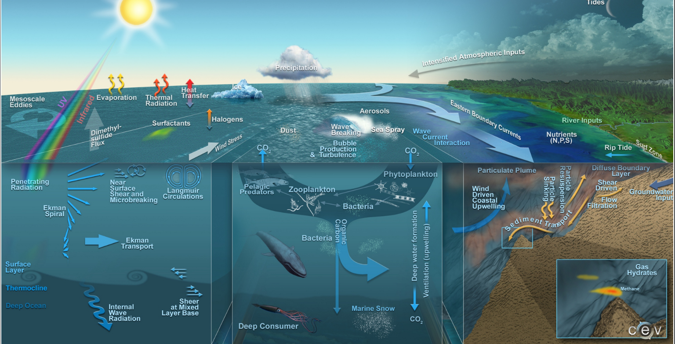
OOI Science Themes
Overarching: Climate Change, Carbon Cycle, Acidification, Ecosystem Health
Crossing time & spatial scales
Ocean-Atmosphere Exchange
Climate Variability, Ocean Circulation, Ecosystems
Turbulent Mixing and Biophysical Interactions
Coastal Ocean Dynamics & Ecosystems
Fluid-Rock Interactions & Sub-seafloor Biosphere
Plate-scale Geodynamics

Slide 8
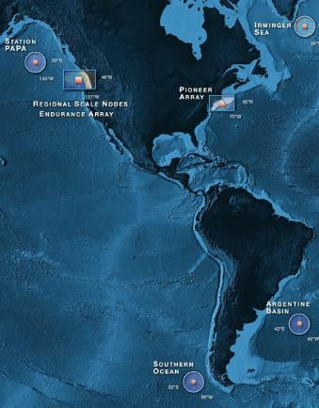
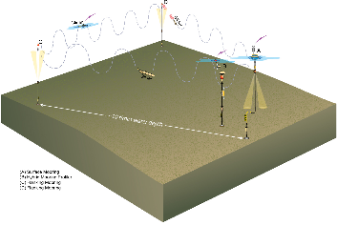
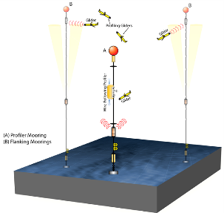
OOI Components: Global Component
Four Global Sites
Flanking Moorings
Profiler Mooring
Gliders (5)
Acoustics

Slide 9
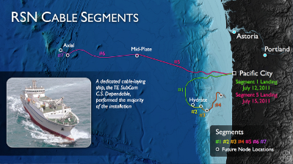
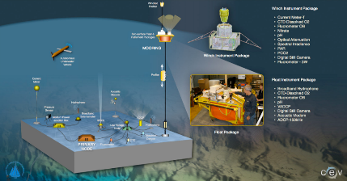
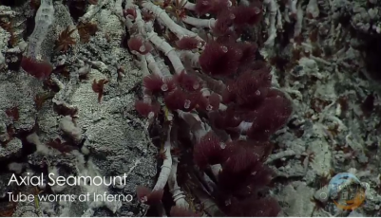
OOI Components: Cabled Array
Moorings
Profilers
HD Video
Met Data

Slide 10
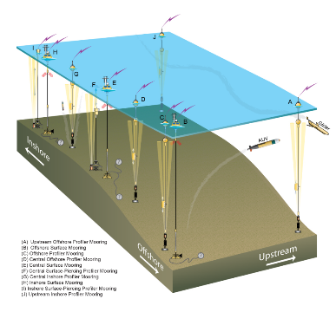
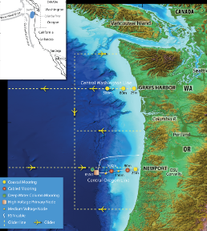
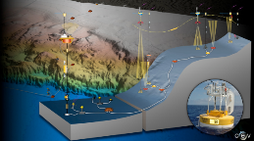
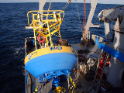
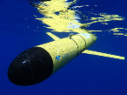
OOI Components: Coastal Component
West Coast: Endurance Array
East Coast: Pioneer Array
Portable
Glider AUVs
REMUS AUVs
Moorings
Profilers
Met Data

Slide 11
OOI By the Numbers
7
50
33
>800
~30K
>100K
Arrays
Sites
Moorings, Profilers, Nodes
Mobile Assets
Gliders, AUVs
Instruments
Science Data Products
Science/Engineering Data Products

Slide 12
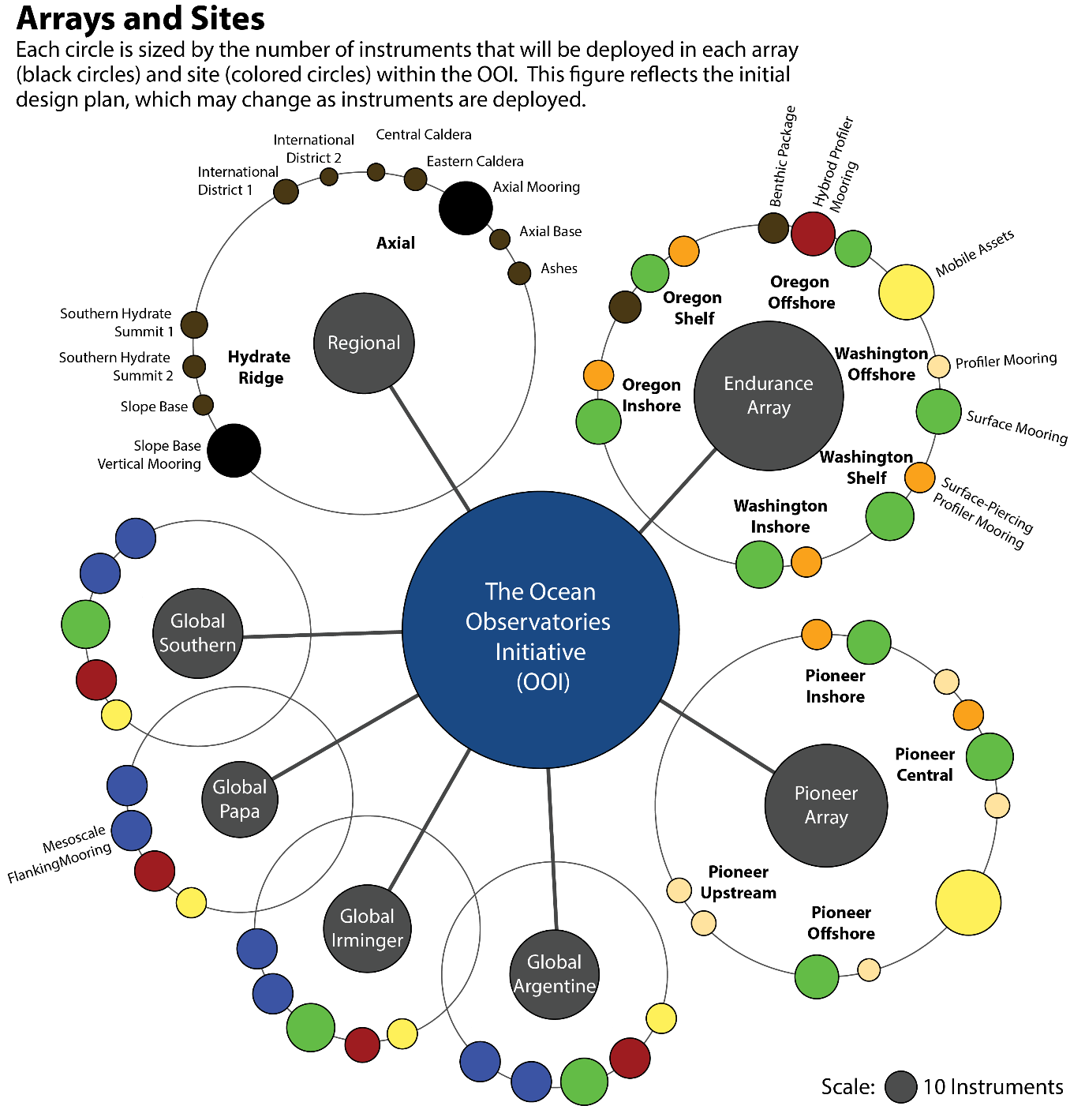
256
704
319
490
192
308
314

Slide 13
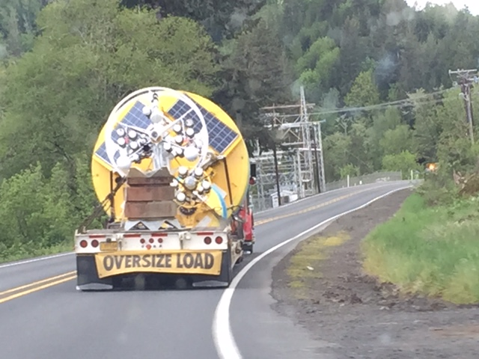

Slide 14
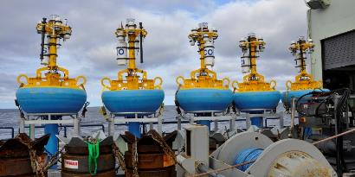
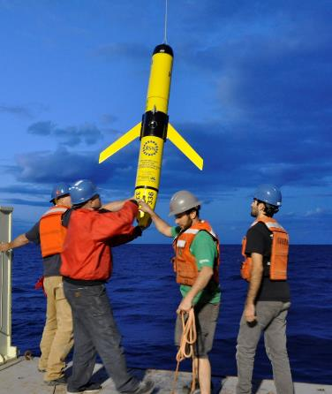
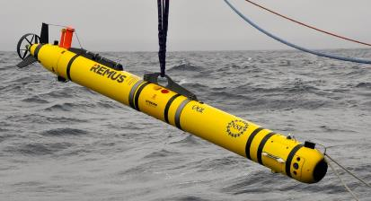
Pioneer Array Deployments
Pioneer surface moorings, Fall 2014
Ocean glider deployments, Spring 2015
REMUS 600 AUV Testing at Pioneer, May 2015

Slide 15
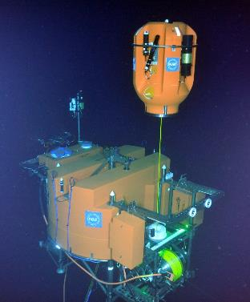
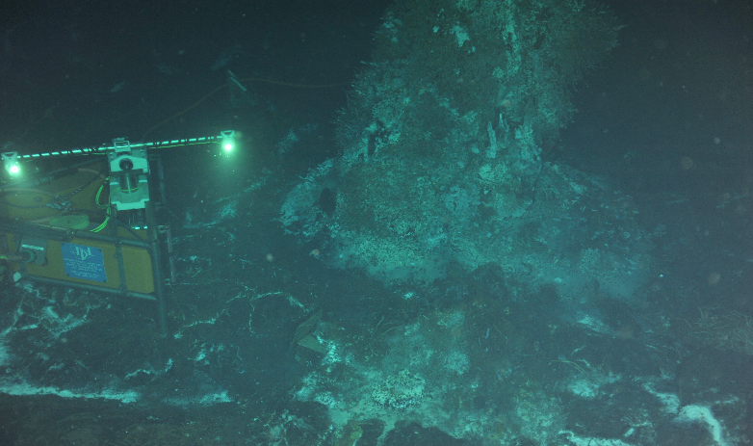
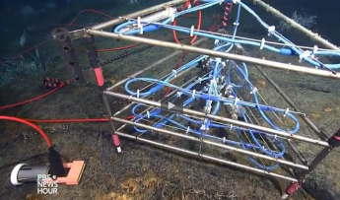
Cabled Observatory Deployments
Digital Still Camera, summer 2014
Shallow Profiler platform on a 2700 m-tall, 2 legged mooring hosting acoustic doppler current profilers, a digital still camera, and chemical and biological sensors (summer 2015).
3D Temperature Sensor, summer 2015

Slide 16
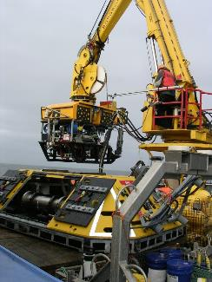
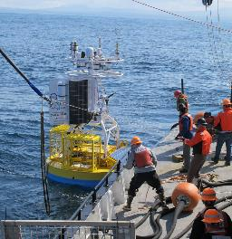
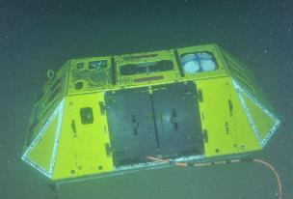
Endurance Array Deployments
ROPOS ROV and Benthic Experiment Package pre- deployment, summer 2014
Benthic Experiment Package (ADCP visible on top), summer 2014
Endurance surface mooring deployment, July 2015

Slide 17
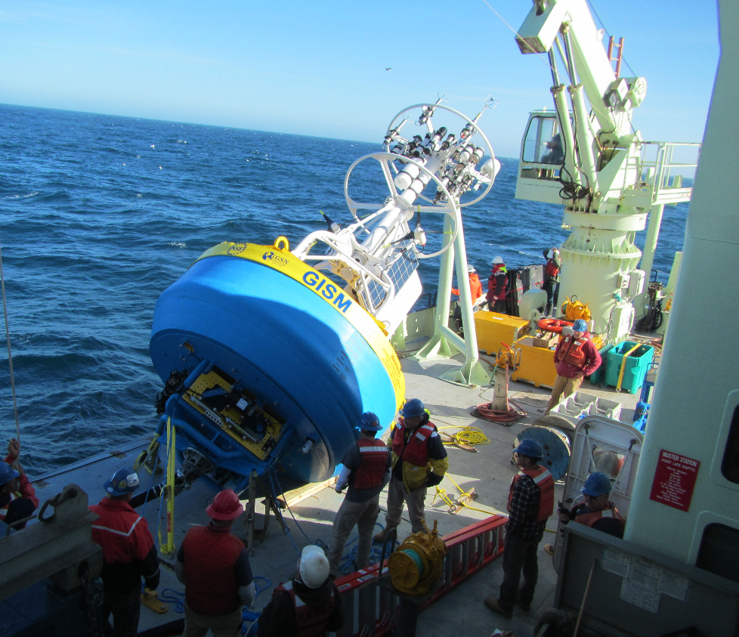
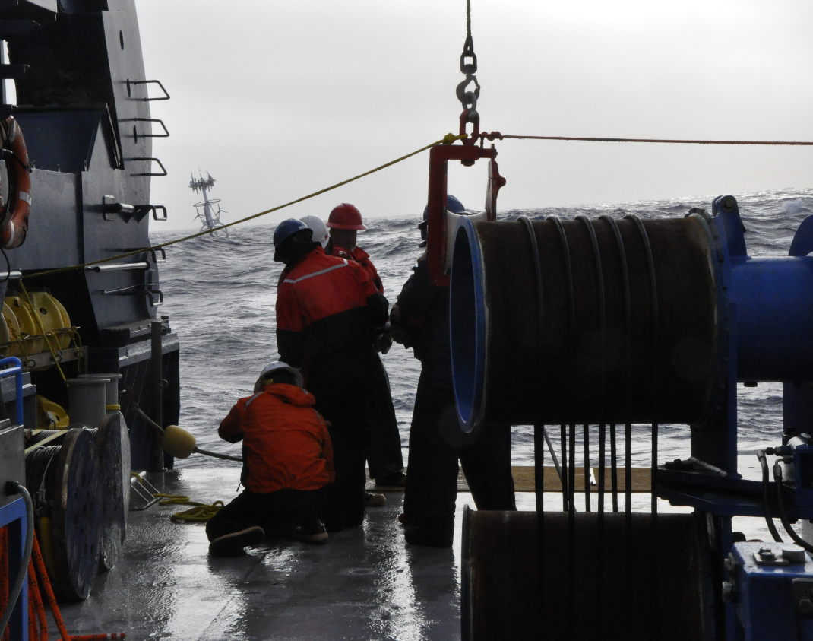
Global Array Deployments
Irminger Surface Mooring, Winter 2014
Southern Ocean, July 2015

Slide 18
Teaching with Data
Erin Bardar, EDC

Slide 19
Introduction to Oceanography
Al Trujillo

Slide 20
Concept Mapping How I Teach Primary Productivity
Annette de Charon, University of Maine

Slide 21
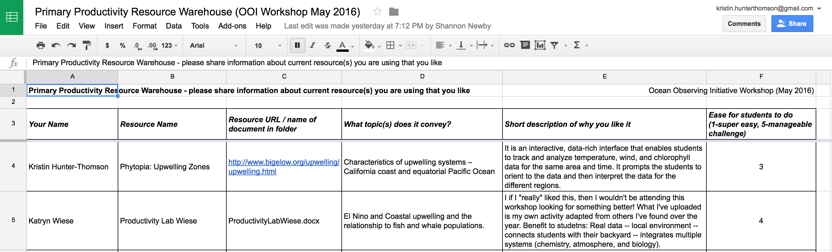
Primary Productivity Resources
https://drive.google.com/drive/folders/0B53yDSDFWmzScHRSQTBtdWhQdUk
Notes:
Friday 8:30pm
We just talked through many great ways we are all teaching primary productivity at the moment in our courses, let’s take a moment to comment to one another about some of the great resources that we have found over the years in our teaching. Some of you shared some already in the google sheet and folder. Those that did, is there something that you would like to say about what you posted? Those that didn’t get a chance to post things yet is there something that you are using that you think others would like to know about?

Slide 22
What we expect from this workshop…
Catherine Halversen, Lawrence Hall of Science

Slide 23

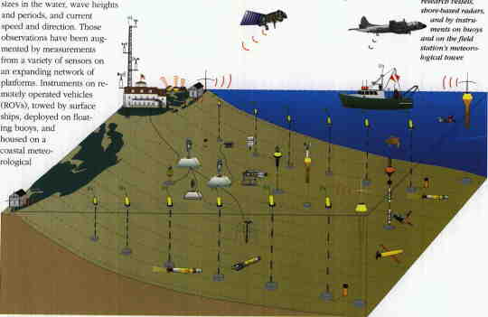
Goals for the Workshop: Background
Long history of interest in teaching with data

Slide 24
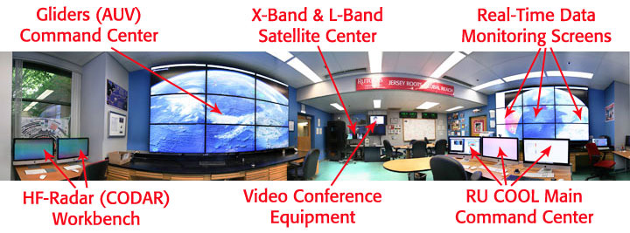
Coastal Ocean Observation Lab

Slide 25
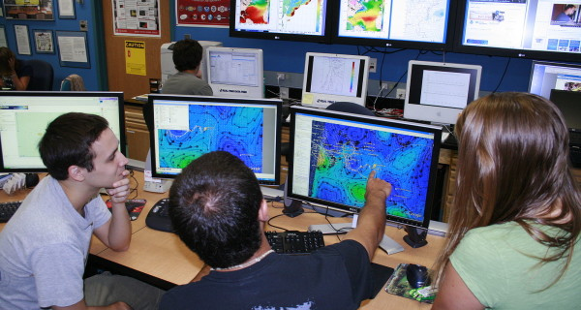
Coastal Ocean Observation Lab

Slide 26
Workshop Objectives
Crosswalk OOI Science themes presented in popular introductory textbooks used in oceanography courses. Compare themes and concepts in the OOI scientific themes document and popular published textbooks to triangulate where OOI data investigations/activities can be woven into existing courses.
Develop sample activities using OOI data/data viz tools and vet them with undergraduate professors.
Brainstorm how best to build a community of practice. Build long-term working relationships and collaborations on data investigation development.
Notes:
hands-on workshop focused on developing effective teaching with data practices using OOI

Slide 27
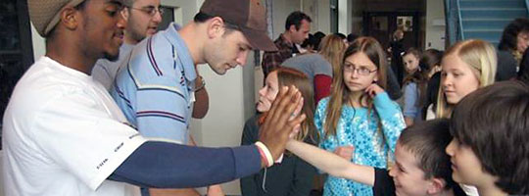
Agenda at a Glance
Friday: Get to know each other; What the nature of our partnership?
Saturday: Review of activities & modify
Sunday: Implementation planning

Slide 28

Thank you! We are excited and grateful for your partnership

